Slide 1
Conservative and Non-conservative Forces

Slide 2
Definition Of A Conservative Force
Conservative force is a such force for which the work done by this force on a particle moving between any two points is independent of the path taken by the particle
The work done by a conservative force on a particle moving through any closed path is zero
A closed path is one in which the beginning and ending points are the same.
The gravitational force has an interesting property that when an object is moved from one place to another, the work done by the gravitational force does not depend on the choice of path.
Forces like these are called conservative forces.

Slide 3
Definition Of a non-conservative Force
A force is non-conservative when the work it does on a moving object is dependent of the path between the object's initial and final positions.
A non-conservative force does not satisfy the conditions of conservative forces
Non-conservative forces acting in a system cause a change in the mechanical energy of the system

Slide 4
Examples
Conservative Forces
Gravitational force
Elastic spring force
Electric force
Non conservative Forces
Static and kinetic frictional forces
Air resistance
Tension
Normal force
Propulsion force of a rocket

Slide 5
Conservative and non-conservative forces •A conservative force allows conversion between kinetic and potential energy. Gravity and the spring force are conservative. •The work done between two points by any conservative force: a) is reversible. b) is independent of the path between the two points. c) is zero if the starting and ending points are the same.

Slide 6
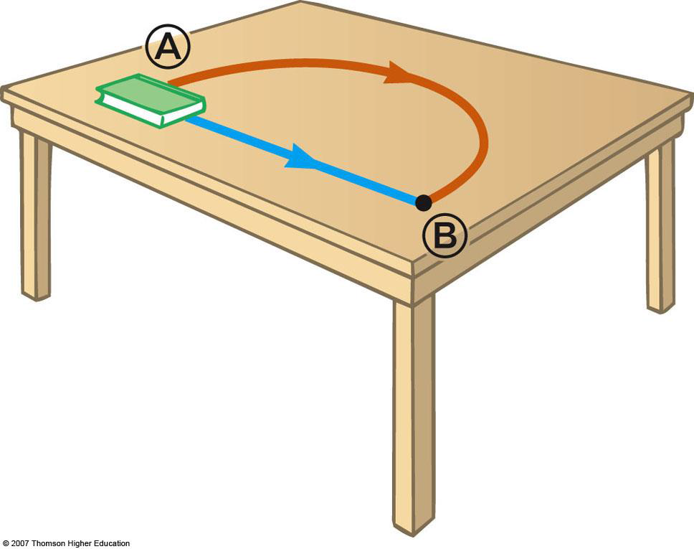
Non-conservative Forces A force (such as friction) that is not conservative is called a non-conservative force, or a dissipative force. The value of work done by friction is greater along the brown path than along the blue path Because the work done depends on the path, friction is a non-conservative force

Slide 7
Non‐conservative forces: Non‐conservative forces are also called dissipative forces, as they dissipate mechanical energy into other forms. For example, friction can dissipate energy as heat and as sound. Water drag and air resistance can dissipate energy as a wave, or as turbulence in a wake. In physics, dissipation (or degradation) of energy refers to the transfer of energy into some form in which it is less available for doing work.

Slide 8
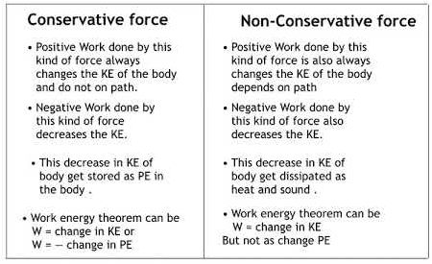
Difference

Slide 9
Thank you

